Slide 1


Slide 2
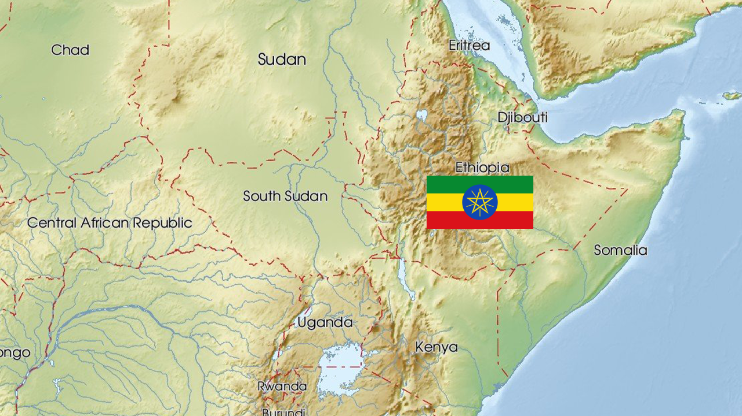

Slide 3
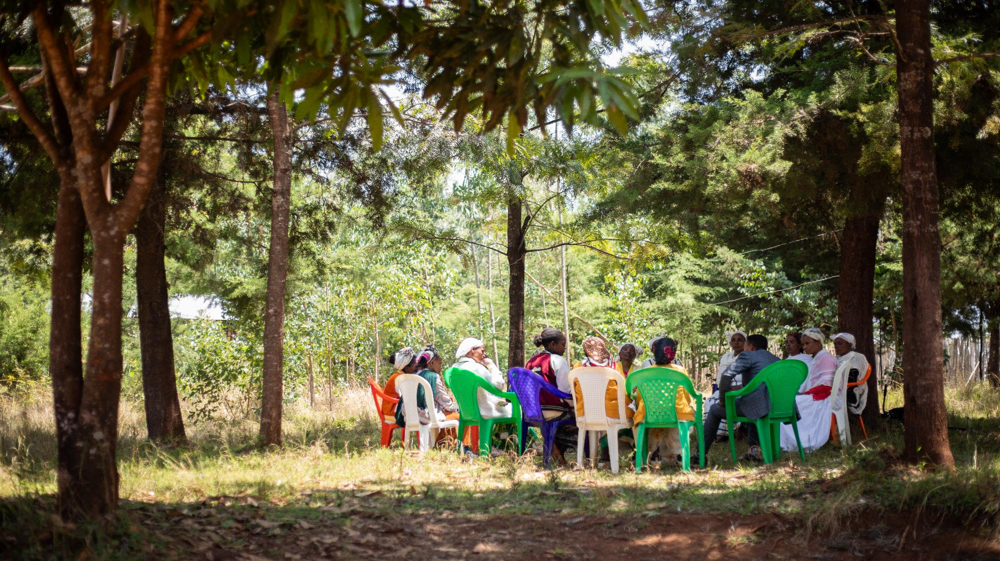
Terepeza Development Association
Notes:
Photo credit: Chris Nelson, Storyhouse Films

Slide 4
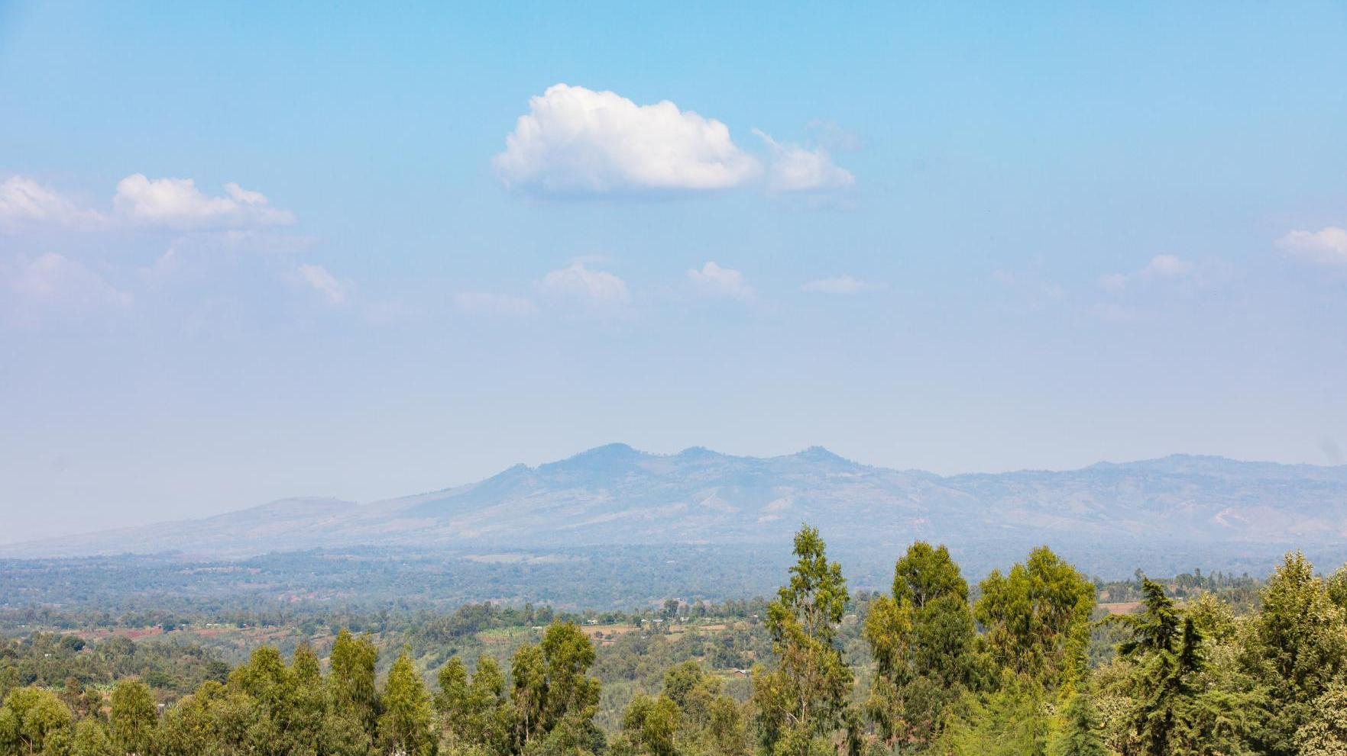
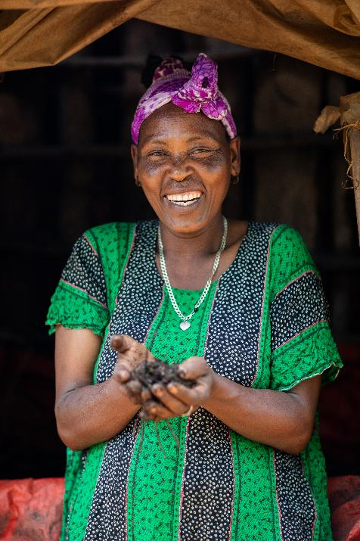
Notes:
Photo credit: Chris Nelson, Storyhouse Films

Slide 5
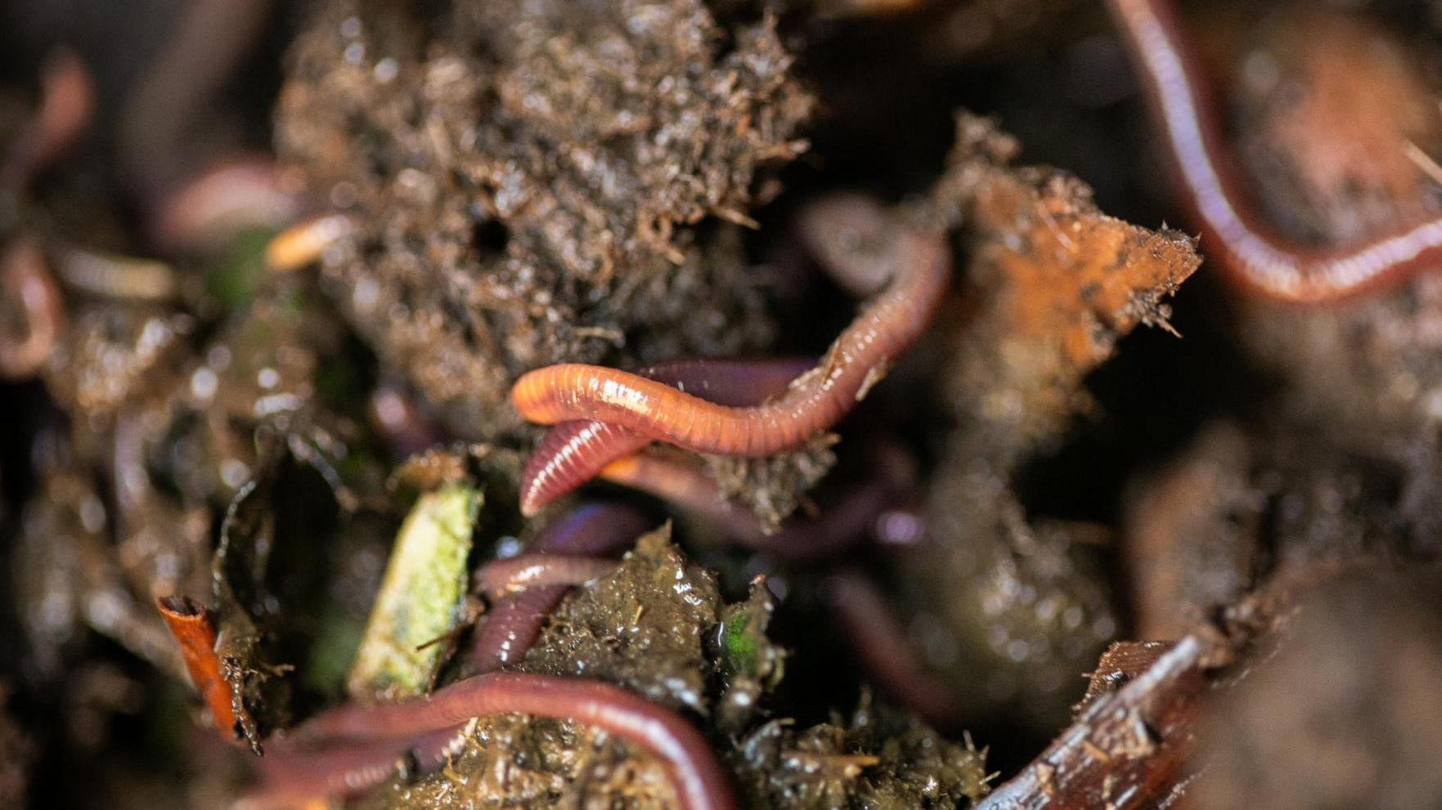
Notes:
Photo credit: Chris Nelson, Storyhouse Films

Slide 6
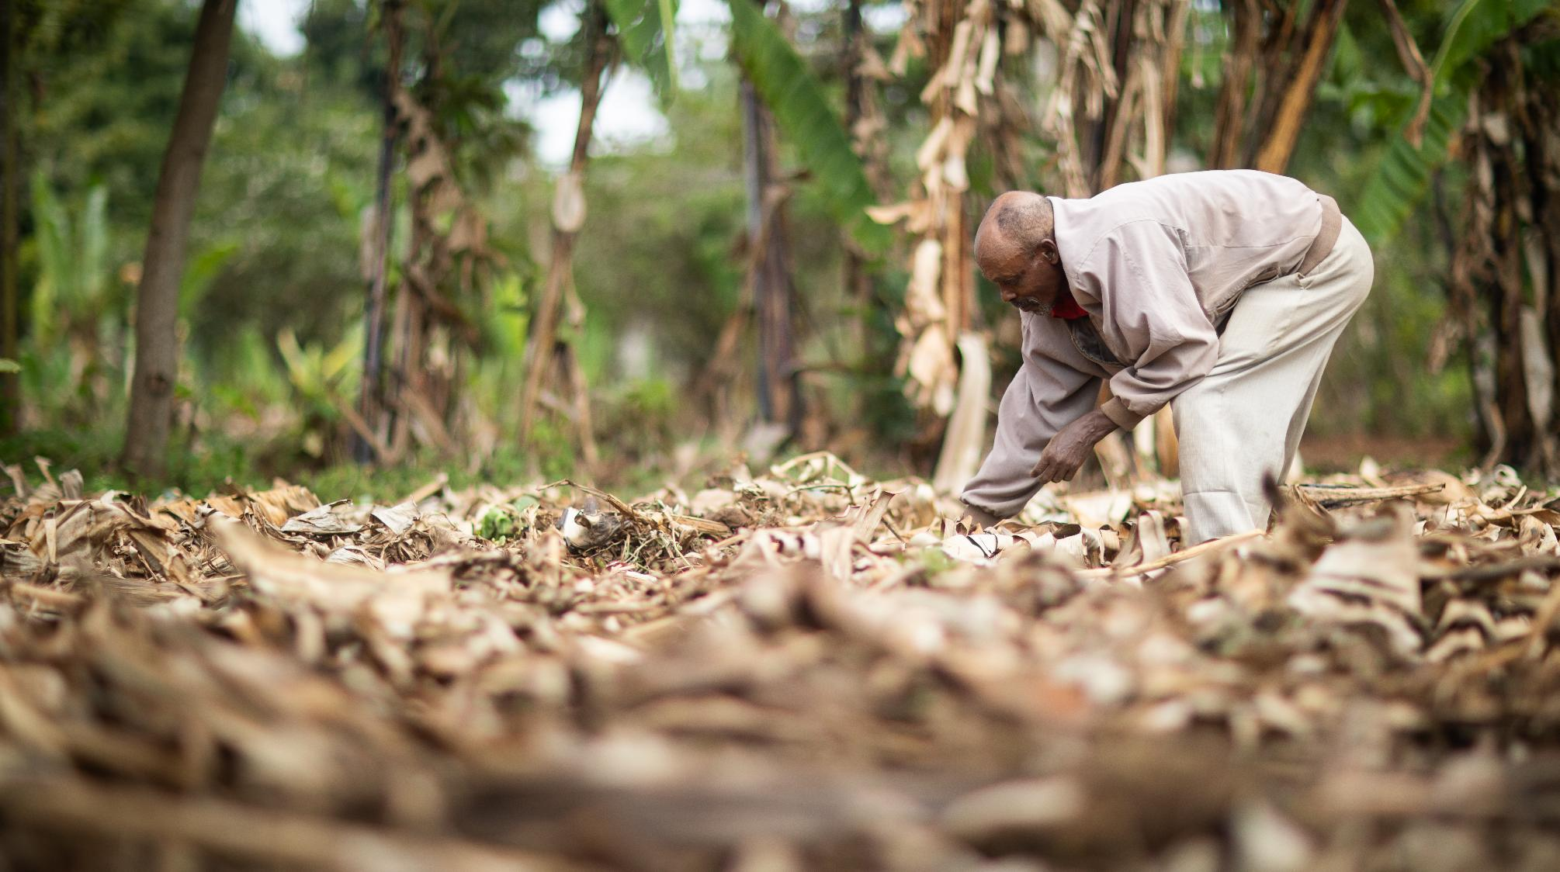
Notes:
Photo credit: Chris Nelson, Storyhouse Films

Slide 7
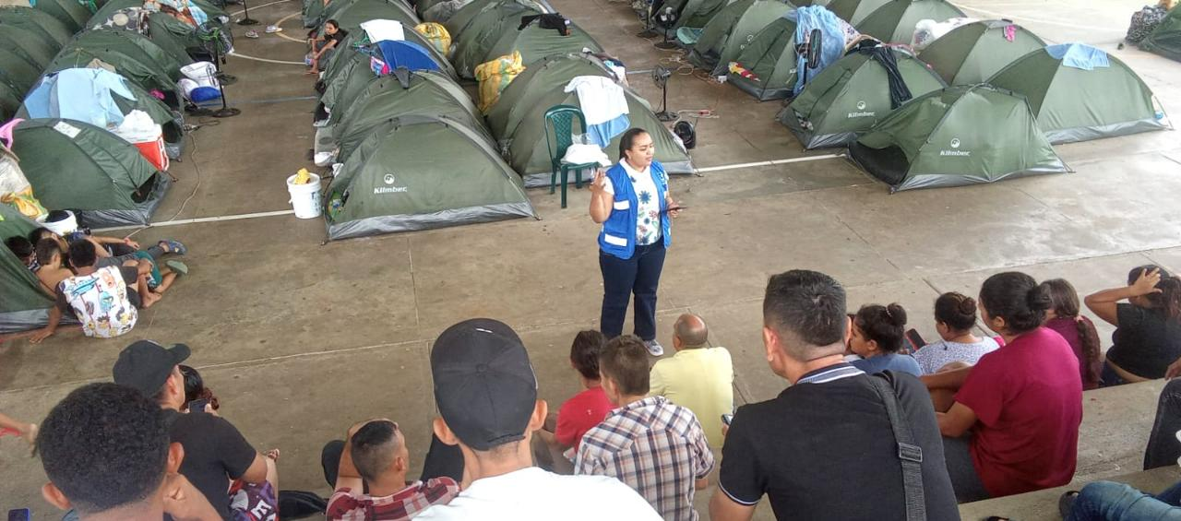
Notes:
Photo Credit: IELCO Evangelical Lutheran Church of Colombia

Slide 8
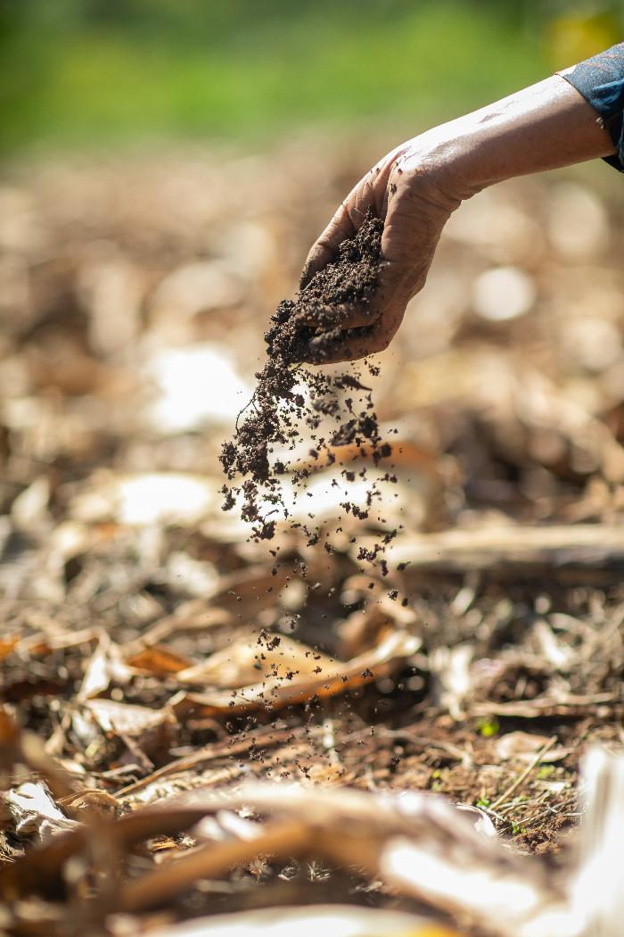
Pray for:
Terepeza Development Association as they equip local congregations in Ethiopia to empower their communities
Communities worldwide affected by extreme weather
Communities affected by violence, such as those in Colombia, where Christian Aid partners, like IELCO work
Notes:
Photo credit: Chris Nelson, Storyhouse Films

