Slide 1



World Development Appeal 2026
Children’s Address

Slide 2
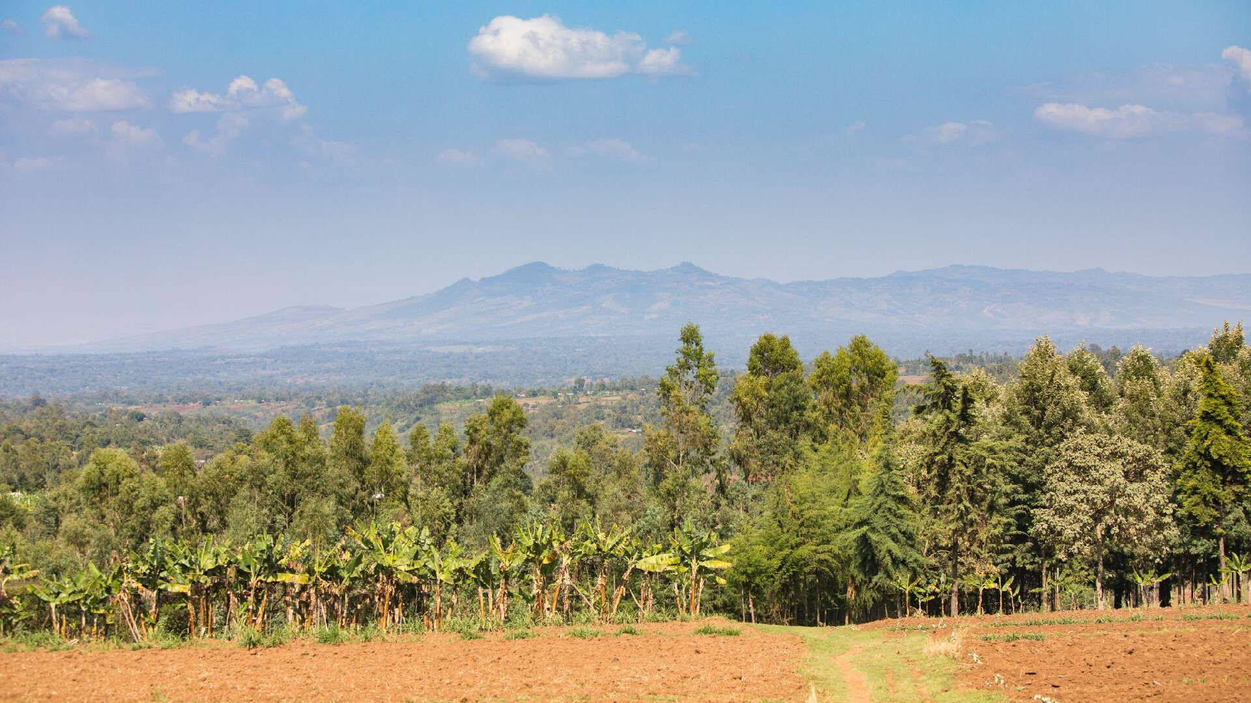


Wolaita, Ethiopia

Slide 3

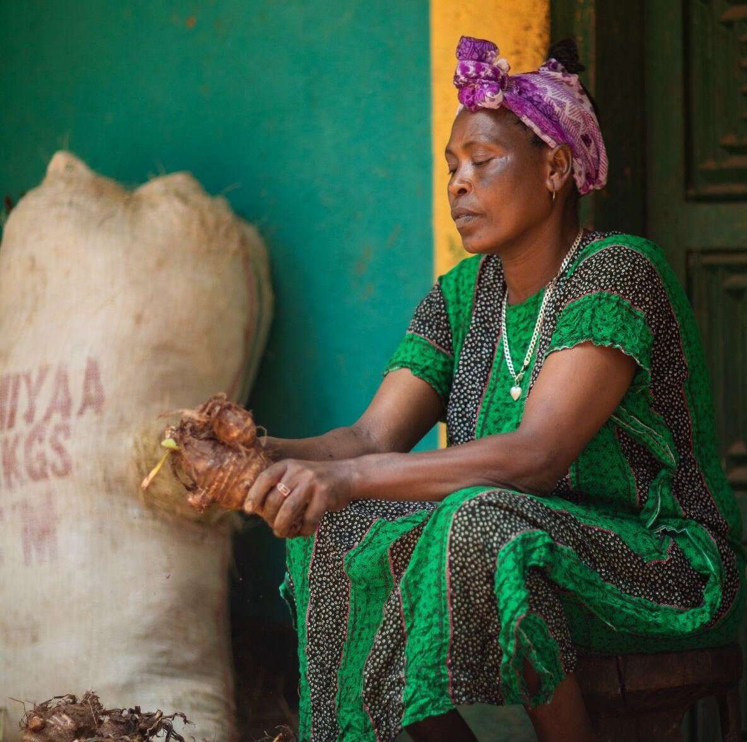
Ayelech’s story
Photo: Chris Nelson/Tearfund

Slide 4

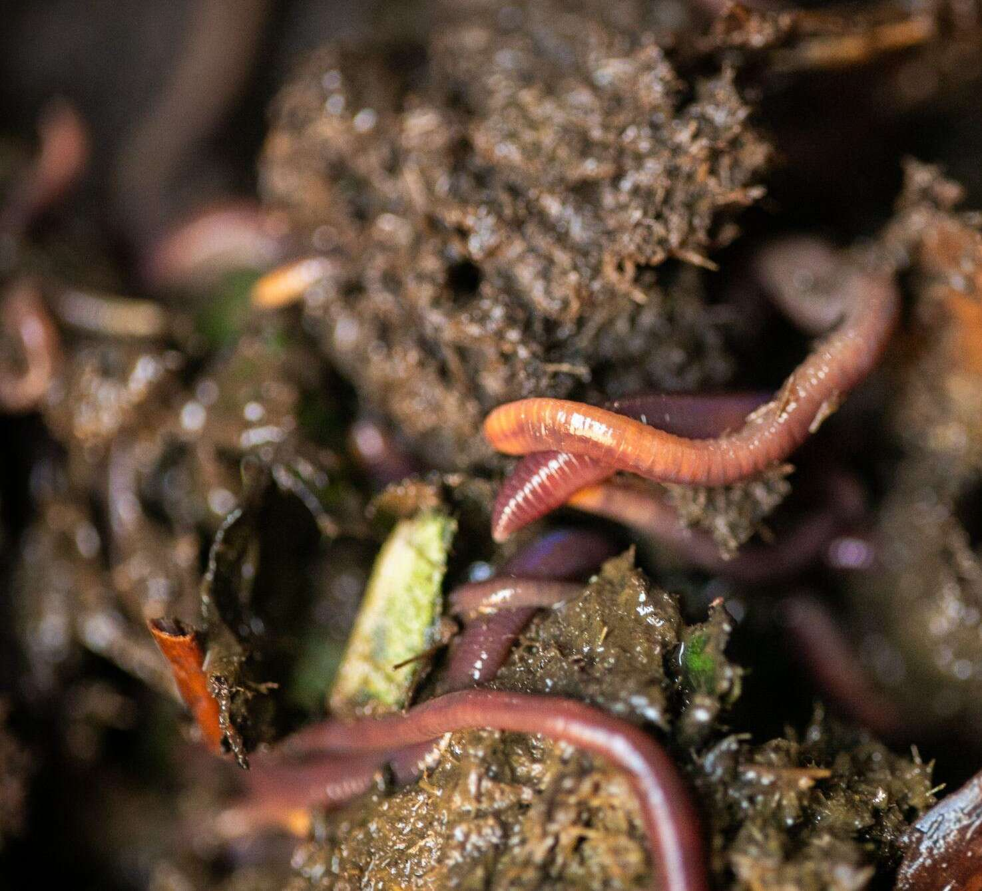
The Humble Worm
Red Wiggler worms
Photo: Chris Nelson/Tearfund

Slide 5


A hotel

Slide 6
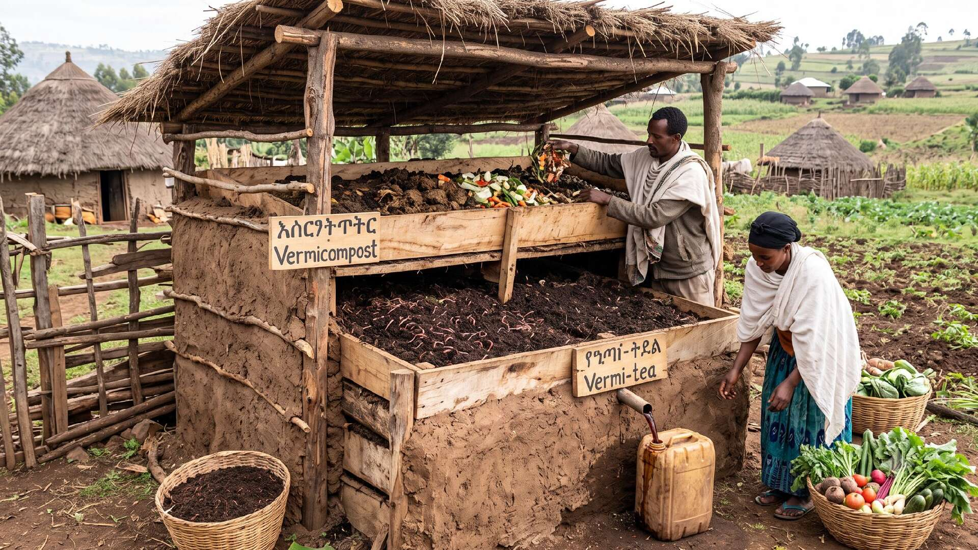
A worm hotel

Slide 7



Slide 8
“See I am doing a new thing!
Now it springs up,
do you not perceive it?”
Isaiah 43: 19

Slide 9

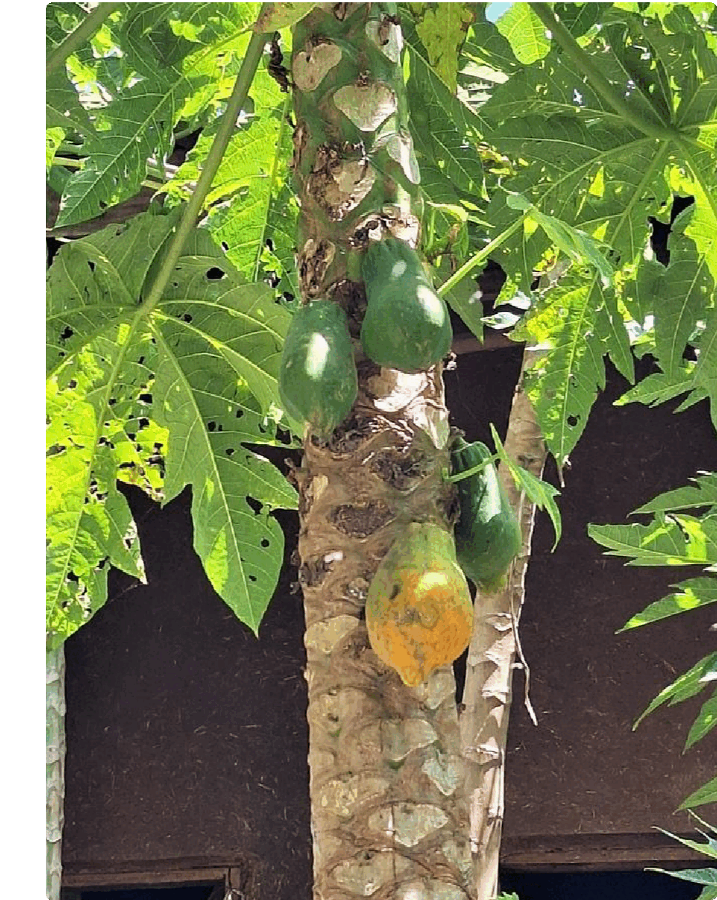
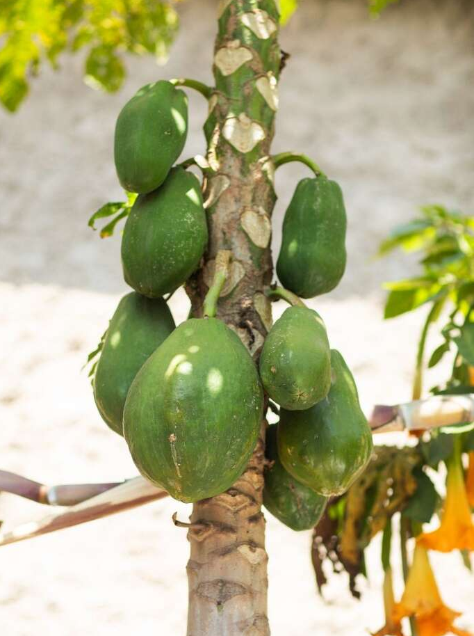
Photos: Chris Nelson/Tearfund

Slide 10
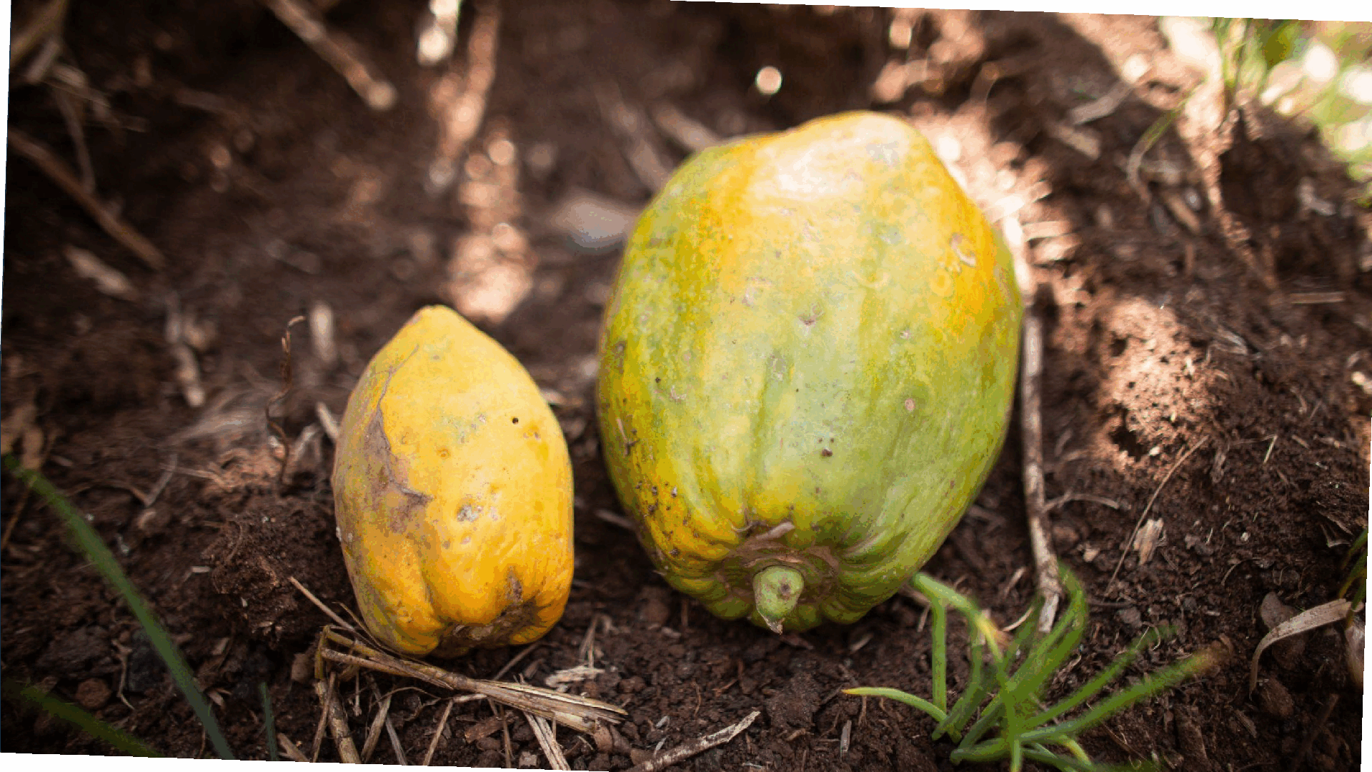

Slide 11
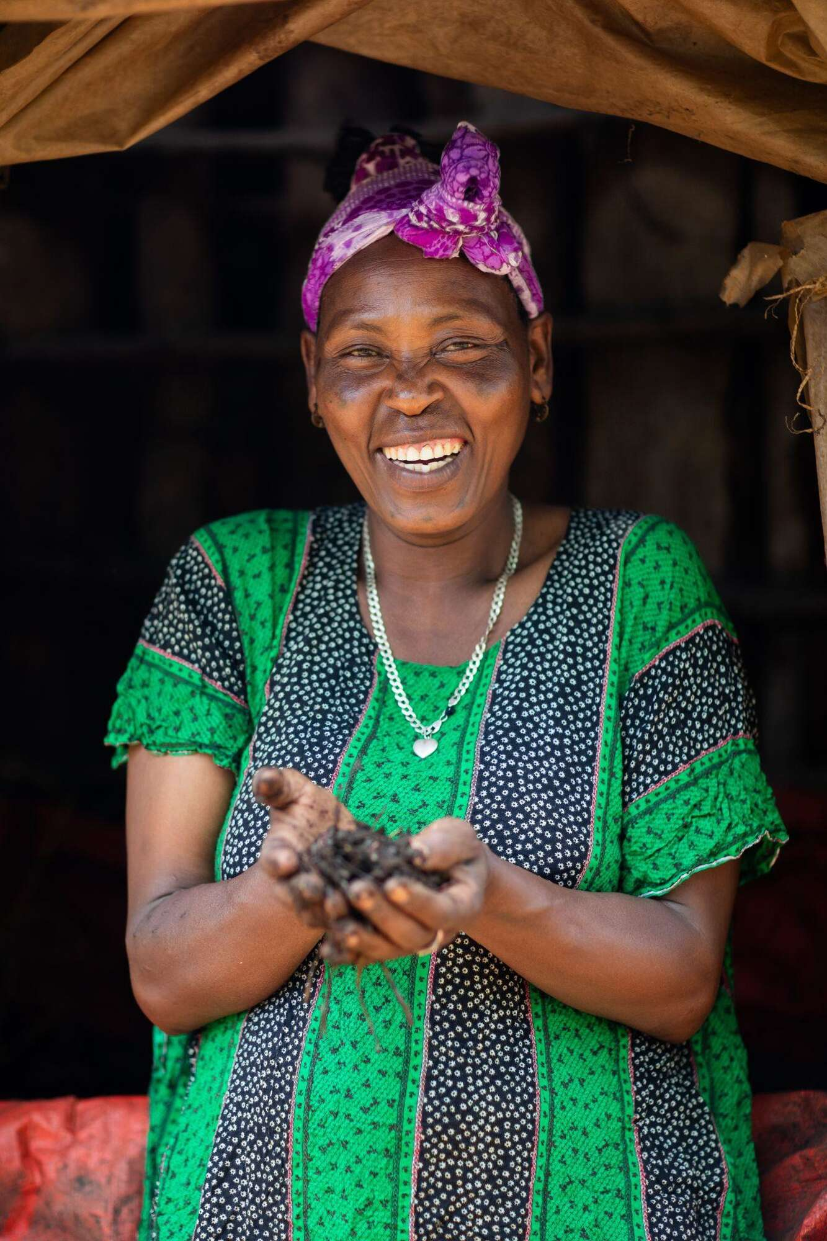


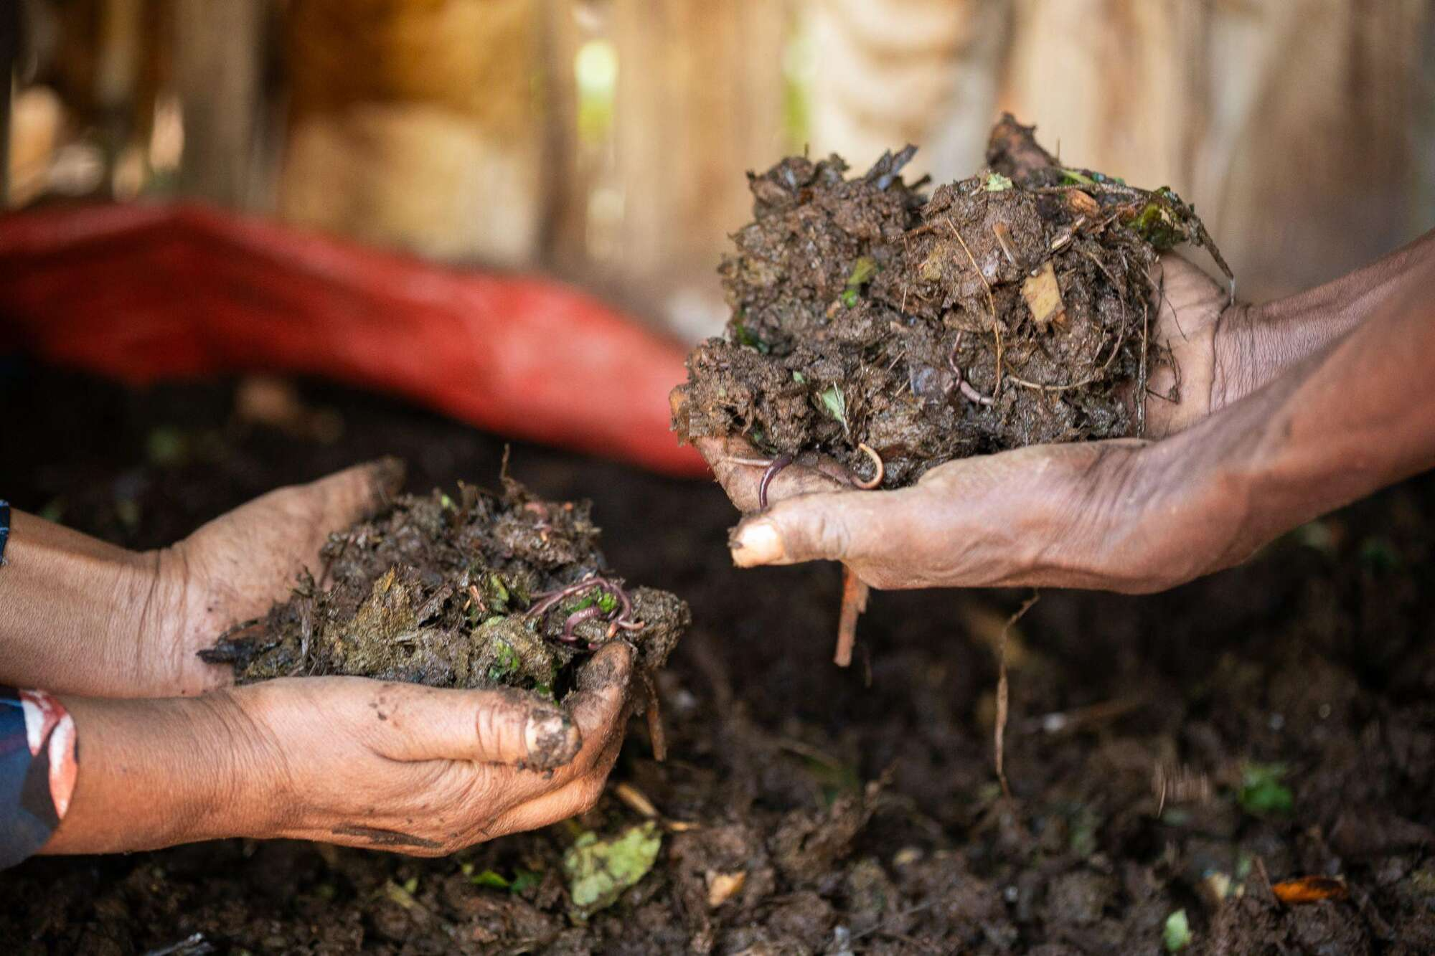
World Development Appeal 2026 - Ethiopia

Slide 12


presbyterianireland.org/world-development

